Slide 1
Airline Booking system
Group Members:
Atul Kumar Verma (IIT2012036)
M. Ravi Teja (IIT2012005)
Nikhil Handa (IIT2012043)

Slide 2
PROBLEM STATEMENT
The main objective of this application is to decrease the manual mistakes engaged in the commercial airline booking process and create it practical for the clients to book the routes as when they require such that they can implement this application to create bookings, change bookings or terminate a particular booking.
This application provides alternatives for watching different routes available with different timings for a particular time frame and provides clients with the service to publication a admission, change or terminate a particular reservation but it does not offer the clients with information of price of the admission and it does not allow the client to alter a particular aspect of his reservation(you can not change details of yourself like name or no. of passengers) and he/she can change all his information.

Slide 3
Entities
The following entities (with its attributes in the parenthesizes, key with an underline) are included in our ER diagram:
USER(email, password, user_name, address, date_of_birth, F_name, L_name)
AIRLINE (Airline_ID, Name)
AIRPORT (Airport_ID, City, Zip, Country, Time_zone)
AIRCRAFT (Aircraft_ID, Model,Year)
FLIGHT (Flight_ID, type_of_flight, availability, fare, first_class_seat, runs_on, delayed_by, arrival_time, departure_time, eco_class_seat, distance)
DATA_ENTRY_OPERATOR (username, name, password, email_id)
PASSENGER (passenger_id, F_name, L_name, date_of_birth, address)
PAYMENT_DETAILS (card_number, card_type, account_balance,password)

Slide 4
RelationShips
RESERVATION (flight_id,passenger_id,status,class,seat_number,res_id)
ARRIVES (flight_id,airport_id)
DEPARTS(Flight_id,airport_id)
USES(Flight_id,Aircraft_id)

Slide 5
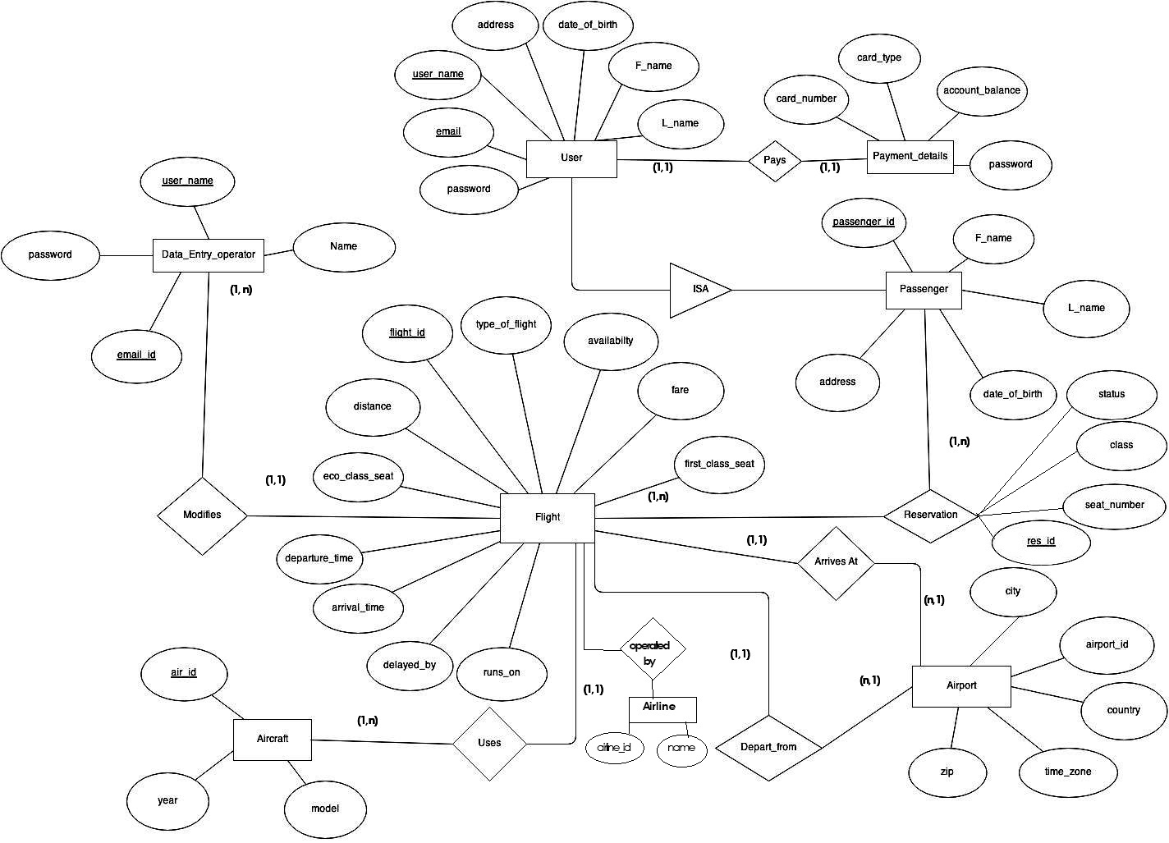

Slide 6
Requirement analysis
Requirement No. | Description | Type | Priority
Req-1 | The User Will be Able to Search the Flights | Functional | Must Have
Req-2 | The user will be able to see flight arrival and departure time, distance of journey, etc. | Functional | Must Have
Req-3 | User must follow the necessary steps to book the flight. | Functional | Must Have
Req-4 | After Booking the User is Able to cancel or modify the booking. | Functional | Must Have
Req-5 | Personal Information can be modified by user after authentication. | Functional | Should Have
Req-6 | User should be updated if the flight is delayed or cancled. | Functional | Must Have

Slide 7
Requirement No. | Description | Type | Priority
Req-7 | Database Admin Maintains the user details and the flight details. | Non Functional | Must Have
Req-8 | ABS should be available 24X7. | Non Functional | Must Have
Req-9 | ABS should provide real time information. | Non Functional | Must Have
Req-10 | Users need to be authenticated before having access to any personal data | Non Functional | Must Have
Req-11 | Only Administrator is given permission to directly access database. | Non Functional | Must Have

Slide 8
Requirement No. | Description | Type | Priority
Req-12 | Standard Personal Computer | Hardware | Must Have
Req-13 | Java Development Kit 1.6 or above | Software | Must Have
Req-14 | Java Runtime Environment | Software | Must Have
Req-15 | Oracle 10g or above for backend | Software | Must Have
Req-16 | Java Integrated Development Kit | Software | Should Have
Req-17 | Windows XP / 7/ 8 | Operating System | Must Have

Slide 9
Normalization
1NF
No composite attributes or repeating groups.
2NF
1 NF plus no partial dependencies.
3NF
2 NF plus no transitive dependencies.

Slide 10
Normalized Tables (up to 3rd normal form)
Login (username, password, address, dob, first_name, last_name, email)
Payment (username, card_number)
Card_Details (card_number, card_type, password, account_balance)
Passenger (passenger_id, first_name, Last_name, dob, address, email)
Reservation (reservation_id, passenger_id, seat_number, flight_id, class)
Running_Schedule (flight_id, day, aircraft, no_of_passengers)
Flight (flight_id, type_of_flight, availability, total_eco_seat, total_business_seat, current_eco_seat, current_busi_seat, airlines)
Arrival (flight_id, airport_id, arrival_time, delayed_by)
Departure (flight_id, airport_id, departure_time, delayed_by)

Slide 11
Normalized Tables (CONt.) (up to 3rd normal form)
Airline (airline_id, name)
Fare_Info (reservation_id, fare, journey_id)
User_Reservation (reservation_id, username)
Distance (journey_id, source, destination, distance)
Flight_Fare (flight_id, journey_id, fare)
Airport (airport_id, airport_name, city_name, country, zip, timezone)
Passenger_identification (passenger_id, id_type, id_number)
Admin (username, password, name, email)

Slide 12
Login table
usename | email | Password | Address | Dob | First_name | Last_name

Slide 13
Payment table
Username | Card_number

Slide 14
Card_Details
Card_no | Card_type | Password | Account_balance

Slide 15
Passenger Table
Passenger_id | First_name | Last_name | Dob | Address | Email

Slide 16
Reservation table
Reservation_id | Passenger_id | Seat_number | Flight_id | Class | status

Slide 17
Running_Schedule
Flight_id | Day | Aircraft | No_of_passenger

Slide 18
Flight table
Flight_id | Type_of_flight | Availability | Total_eco_seat | Total_business_seat | Current_eco_seat | Current_busi_seat | airlines

Slide 19
Arrival table
Flight_id | Airport_id | Arrival_time | Delayed_by

Slide 20
Departure Table
Flight_id | Airport_id | Departure_time | Delayed_by

Slide 21
Airline Table
Airline_id | name

Slide 22
Fare_info table user_reservation table
Reservation_id | fare
Reservation_id | username

Slide 23
Distance table
Journey_id | to | from | distance

Slide 24
Flight_fare table
Flight_id | Journey_id | Fare

Slide 25
Airport table
Airport_id | Airport_name | City_name | Country | zip | timezone

Slide 26
Passenger_identification table
Passenger_id | Id_type | Id_number

Slide 27
Thank you

